Slide 1
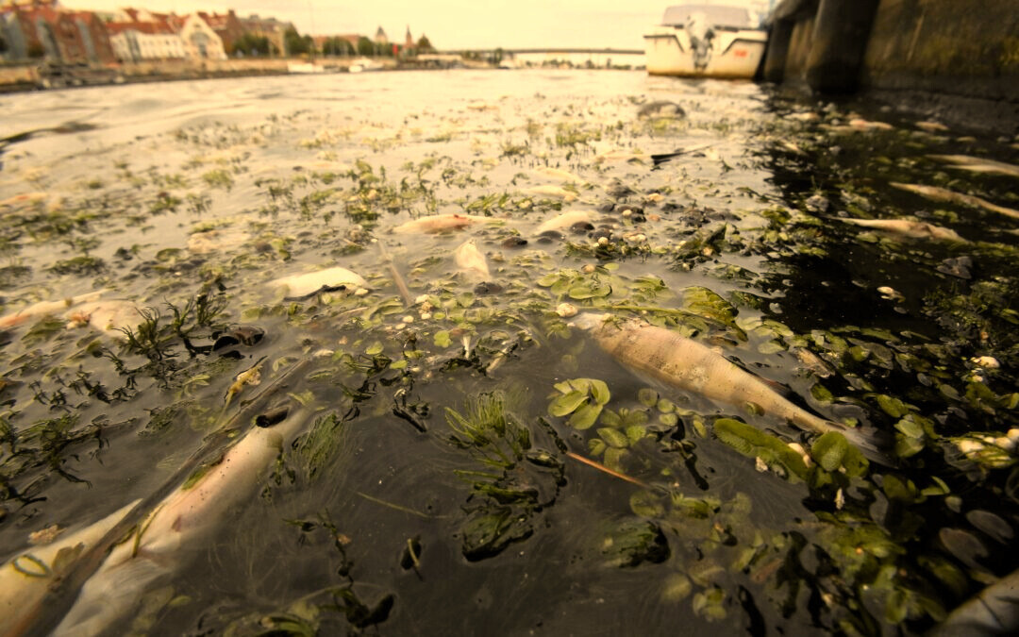

385 MILLION

Slide 2




Problem
The misuse of insecticides in agriculture due to the lack of knowledge of farmers and inability to identify pests before crops are damaged.
Expect insecticides to protect the crops 100%.
Pressure to get immediate results.
Have little to no knowledge on effects of insecticide misuse.
40%
Farmers
Use pesticides prior to symptoms.
Research data

Slide 3



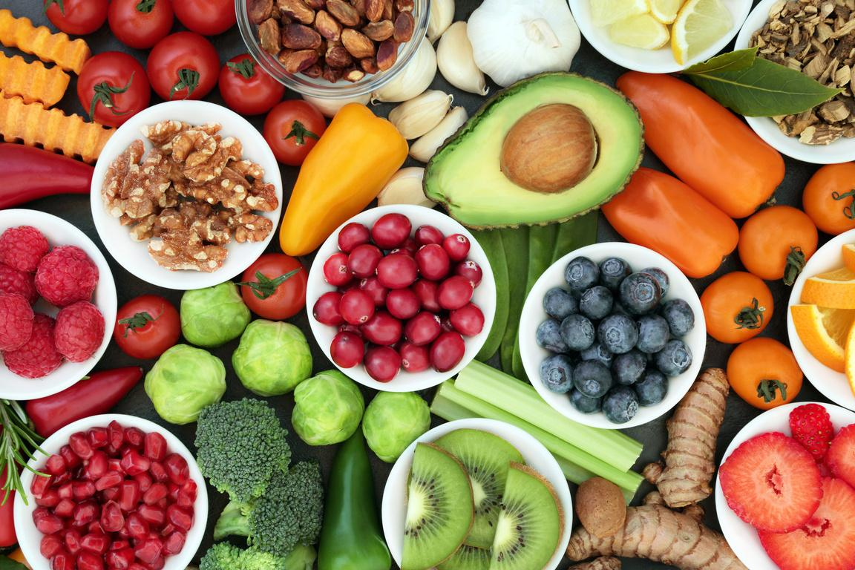
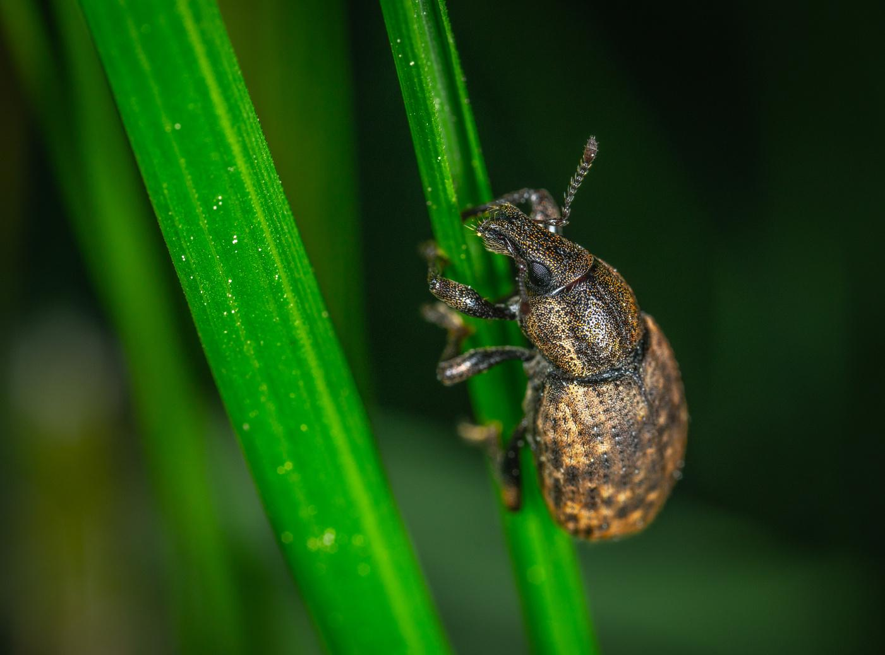
Impacts
Excessive insecticide use
Insecticide resistance
Heavy metals in food
Human health impacts
Water body pollution

Slide 4



PESTSENSE
Team Pathfinders

Slide 5

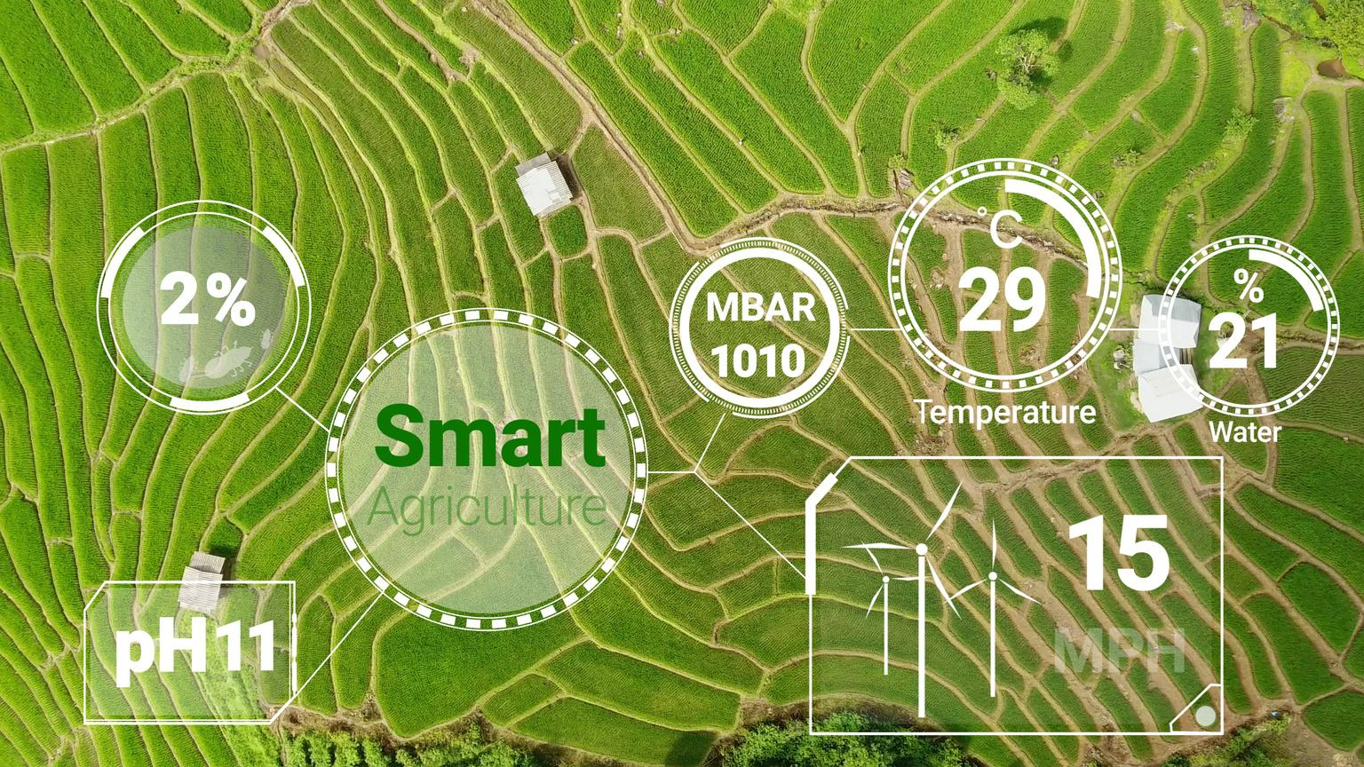




PestSense

Slide 6

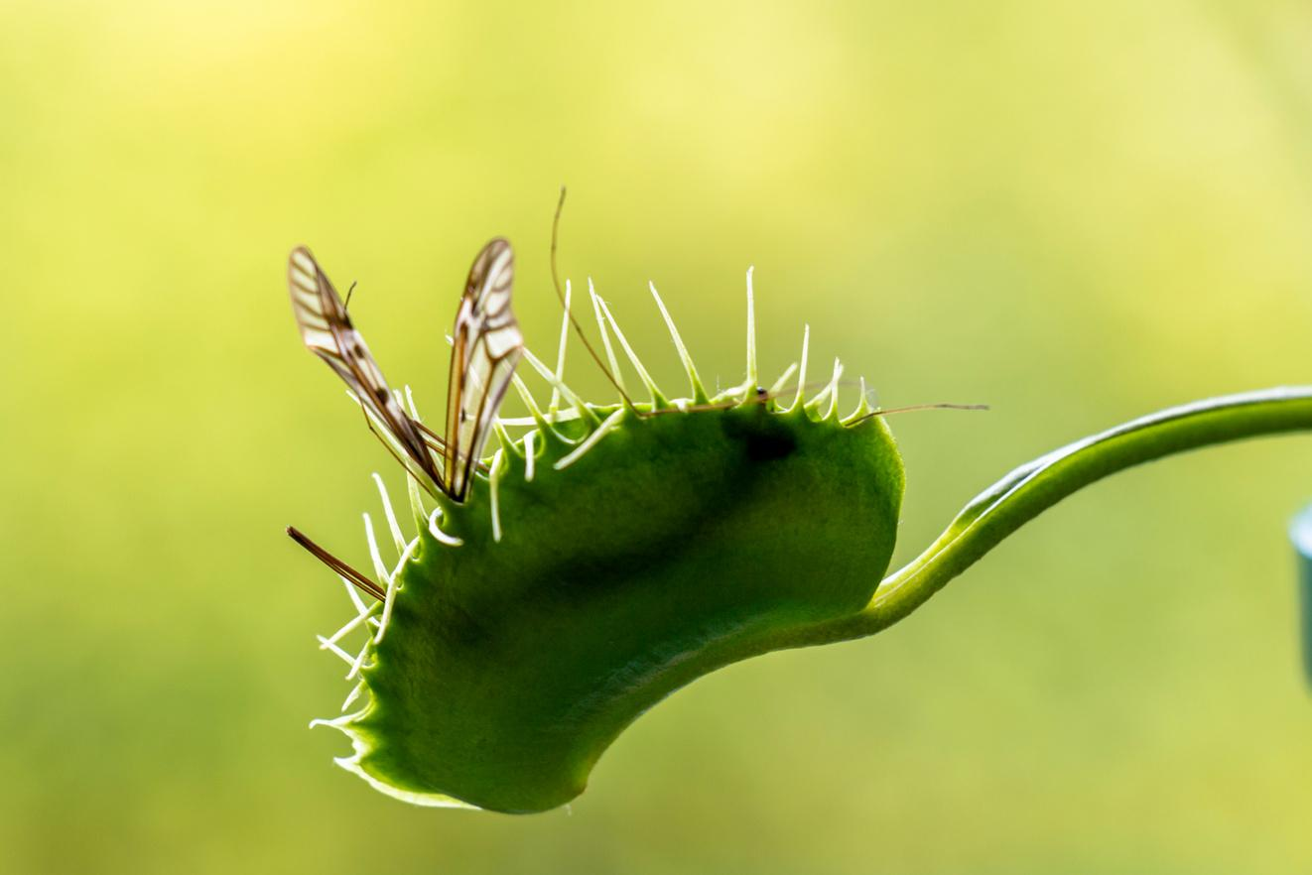



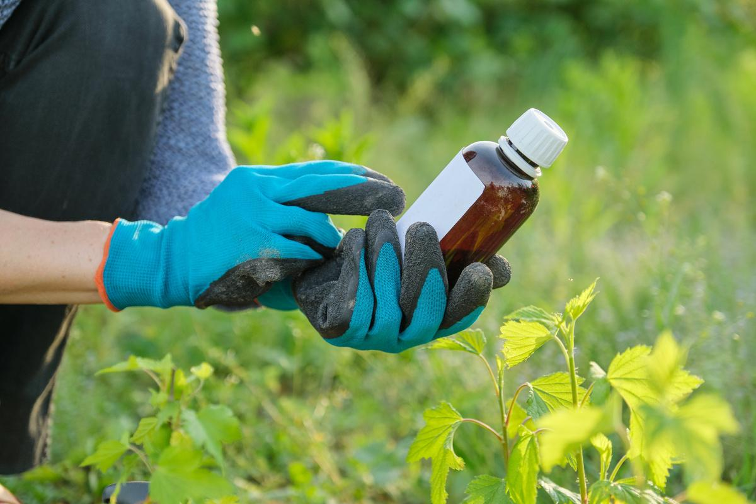
PestSense
Analyse
Implement
Trap
Observe
Predict

Slide 7
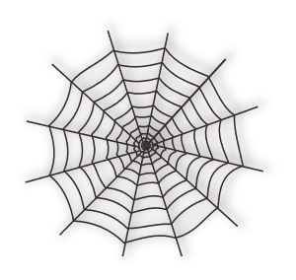



Entotrap functional block diagram
SENSOR
(CAMERA /MIC) CAPTURING DATA
TRANSMITTING DATA TO HUB
(FM)
SUSTAINABLE
ENERGY
SUPPLY
PEST TRAP

Slide 8








CentralHub funtional block diagram
UPTODATE INFORMATION ON INTEGRATED PEST MANAGEMENT
INTELLIGENT & OPTIMIZED SOFTWARE TO PREDICT PEST POPULATION
USER NOTIFICATION FOR REMOTE MONITORING
DATA TRANSMISSION WITH ENTOTRAP
DATA SYNC WITH USER APP

Slide 9



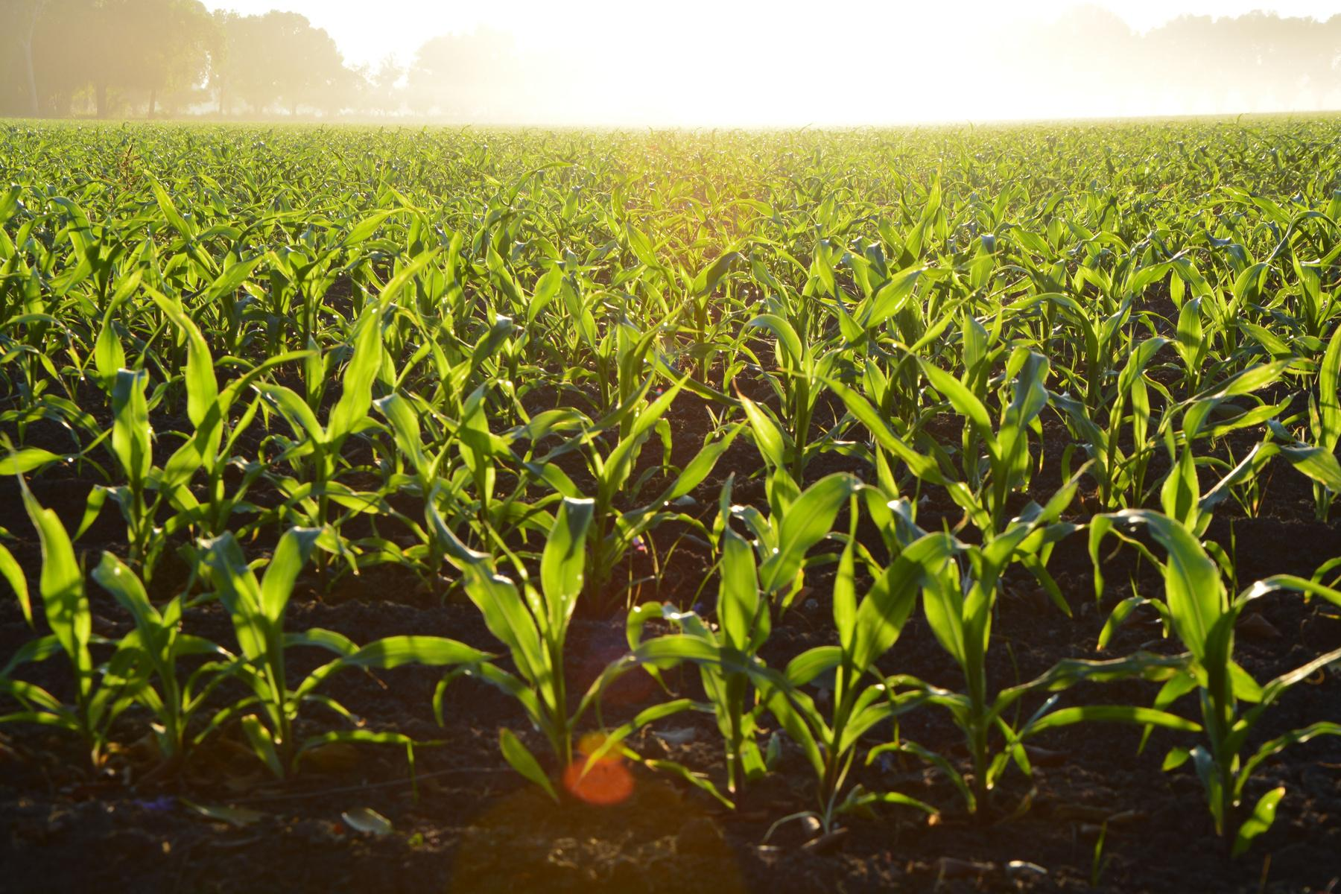
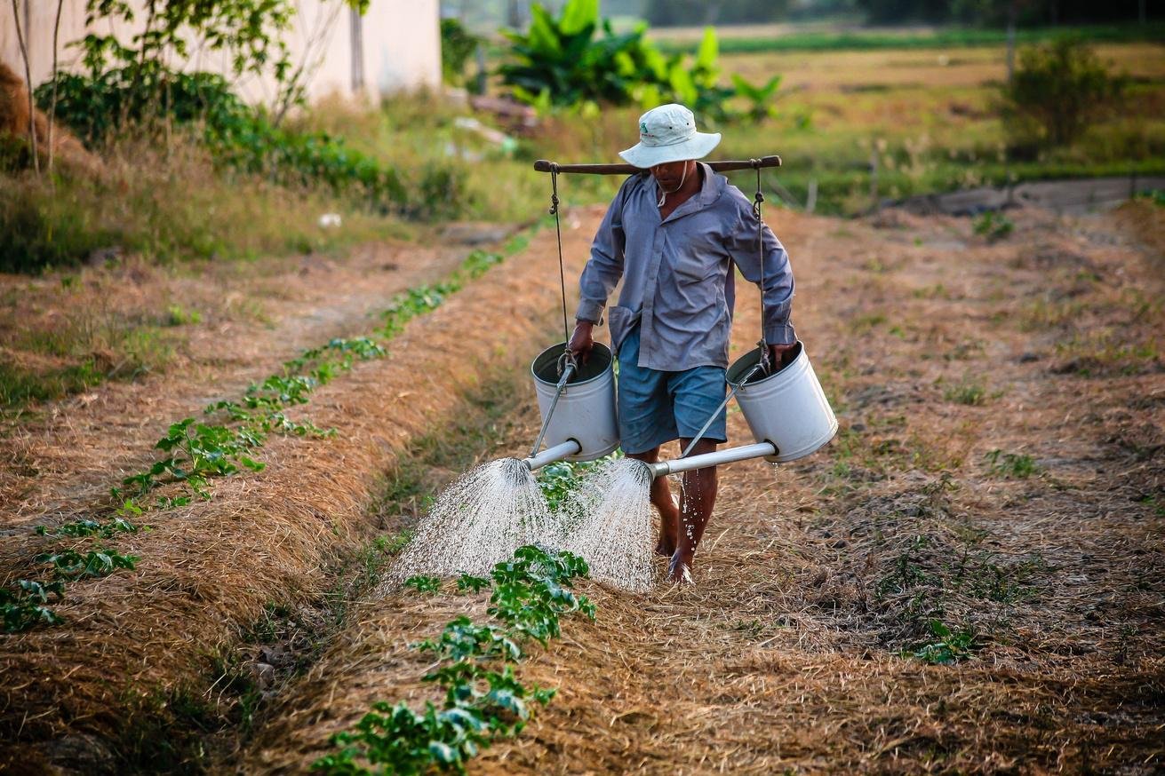
Implementation

Slide 10


Marketing
20%
Expected Savings

Slide 11
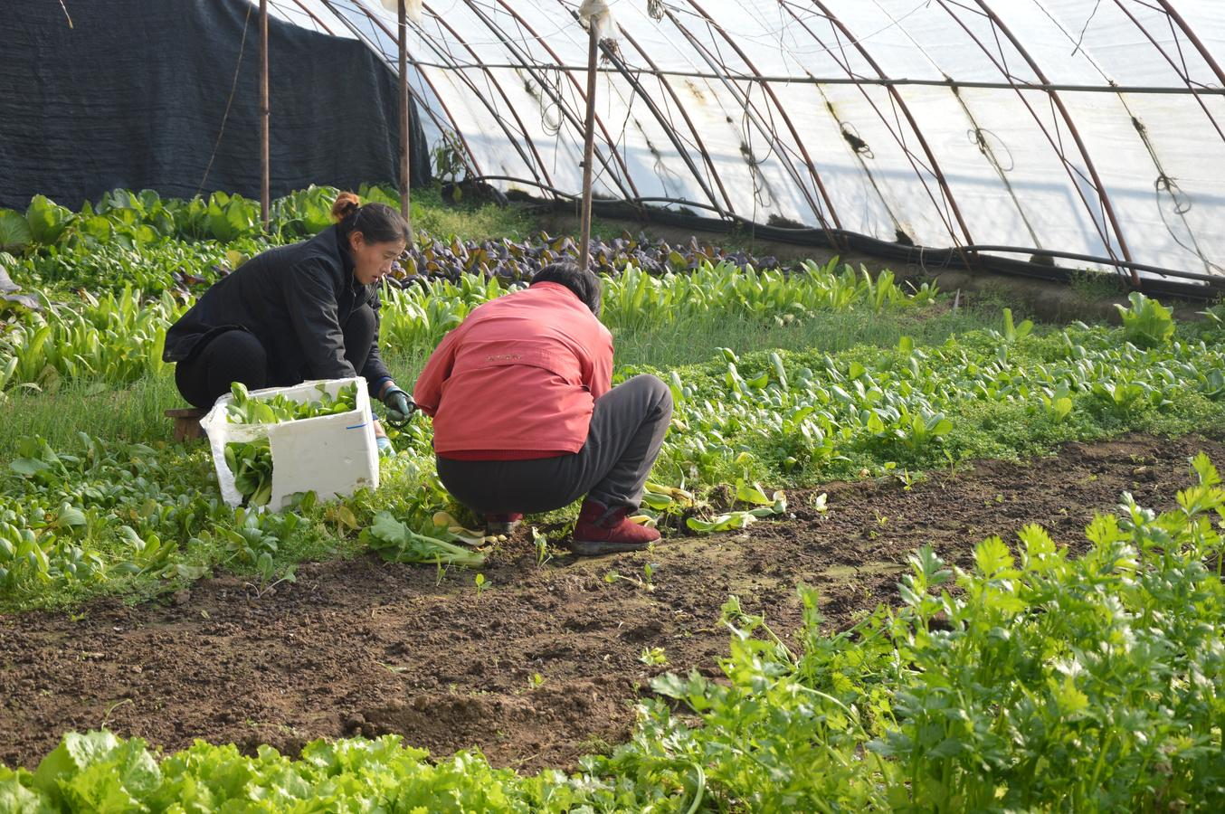
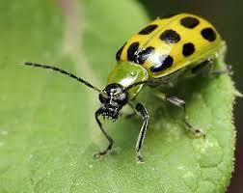

Impacts of PestSense
Preserving biodiversity
17
12
Improving
yield &
quality of crops
Reducing
pest resistance

Slide 12



Impacts of PestSense
Boosting consumer
health
Big
Data
17
12
Organic
Cultivations

Slide 13
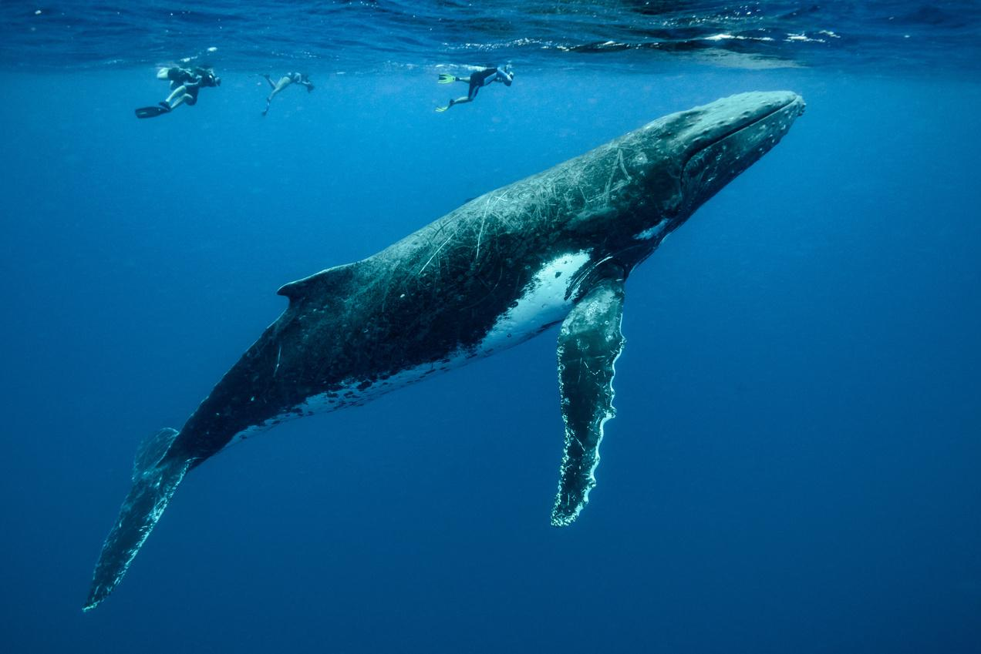
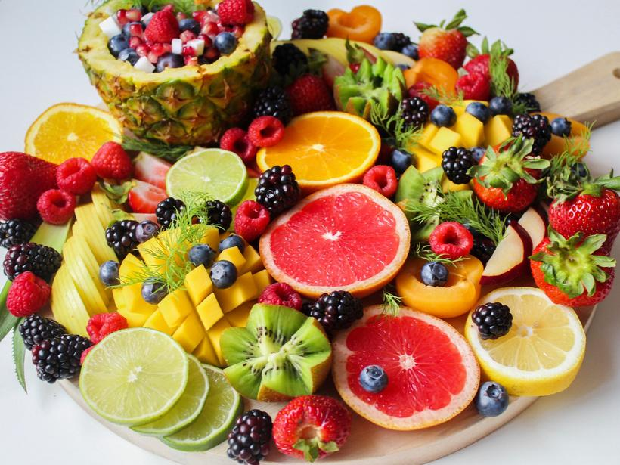
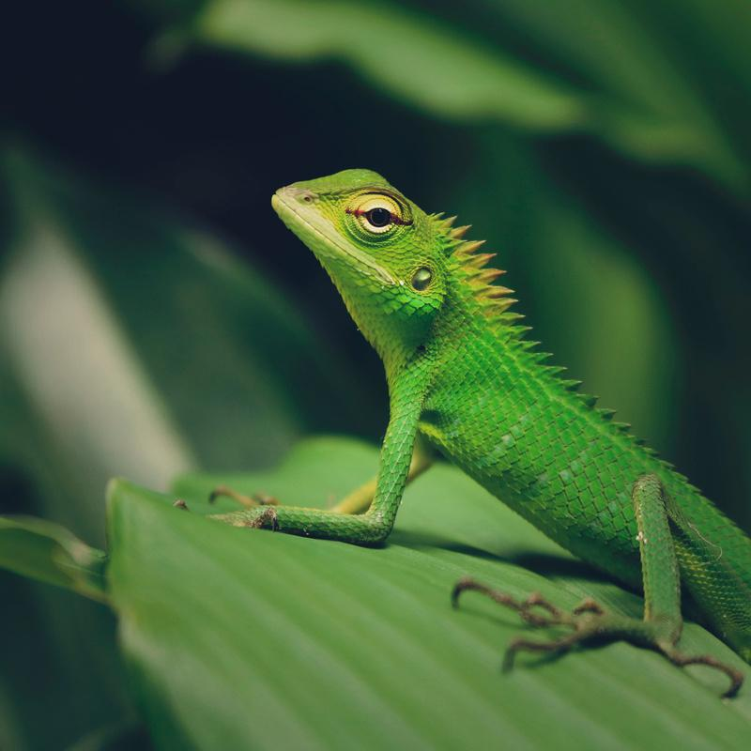

Sustainable Development
Achieving sustainable development goals
13
2
15
12
Climate action
Zero Hunger
Responsible Consumption and Production
Life on Land

Slide 14
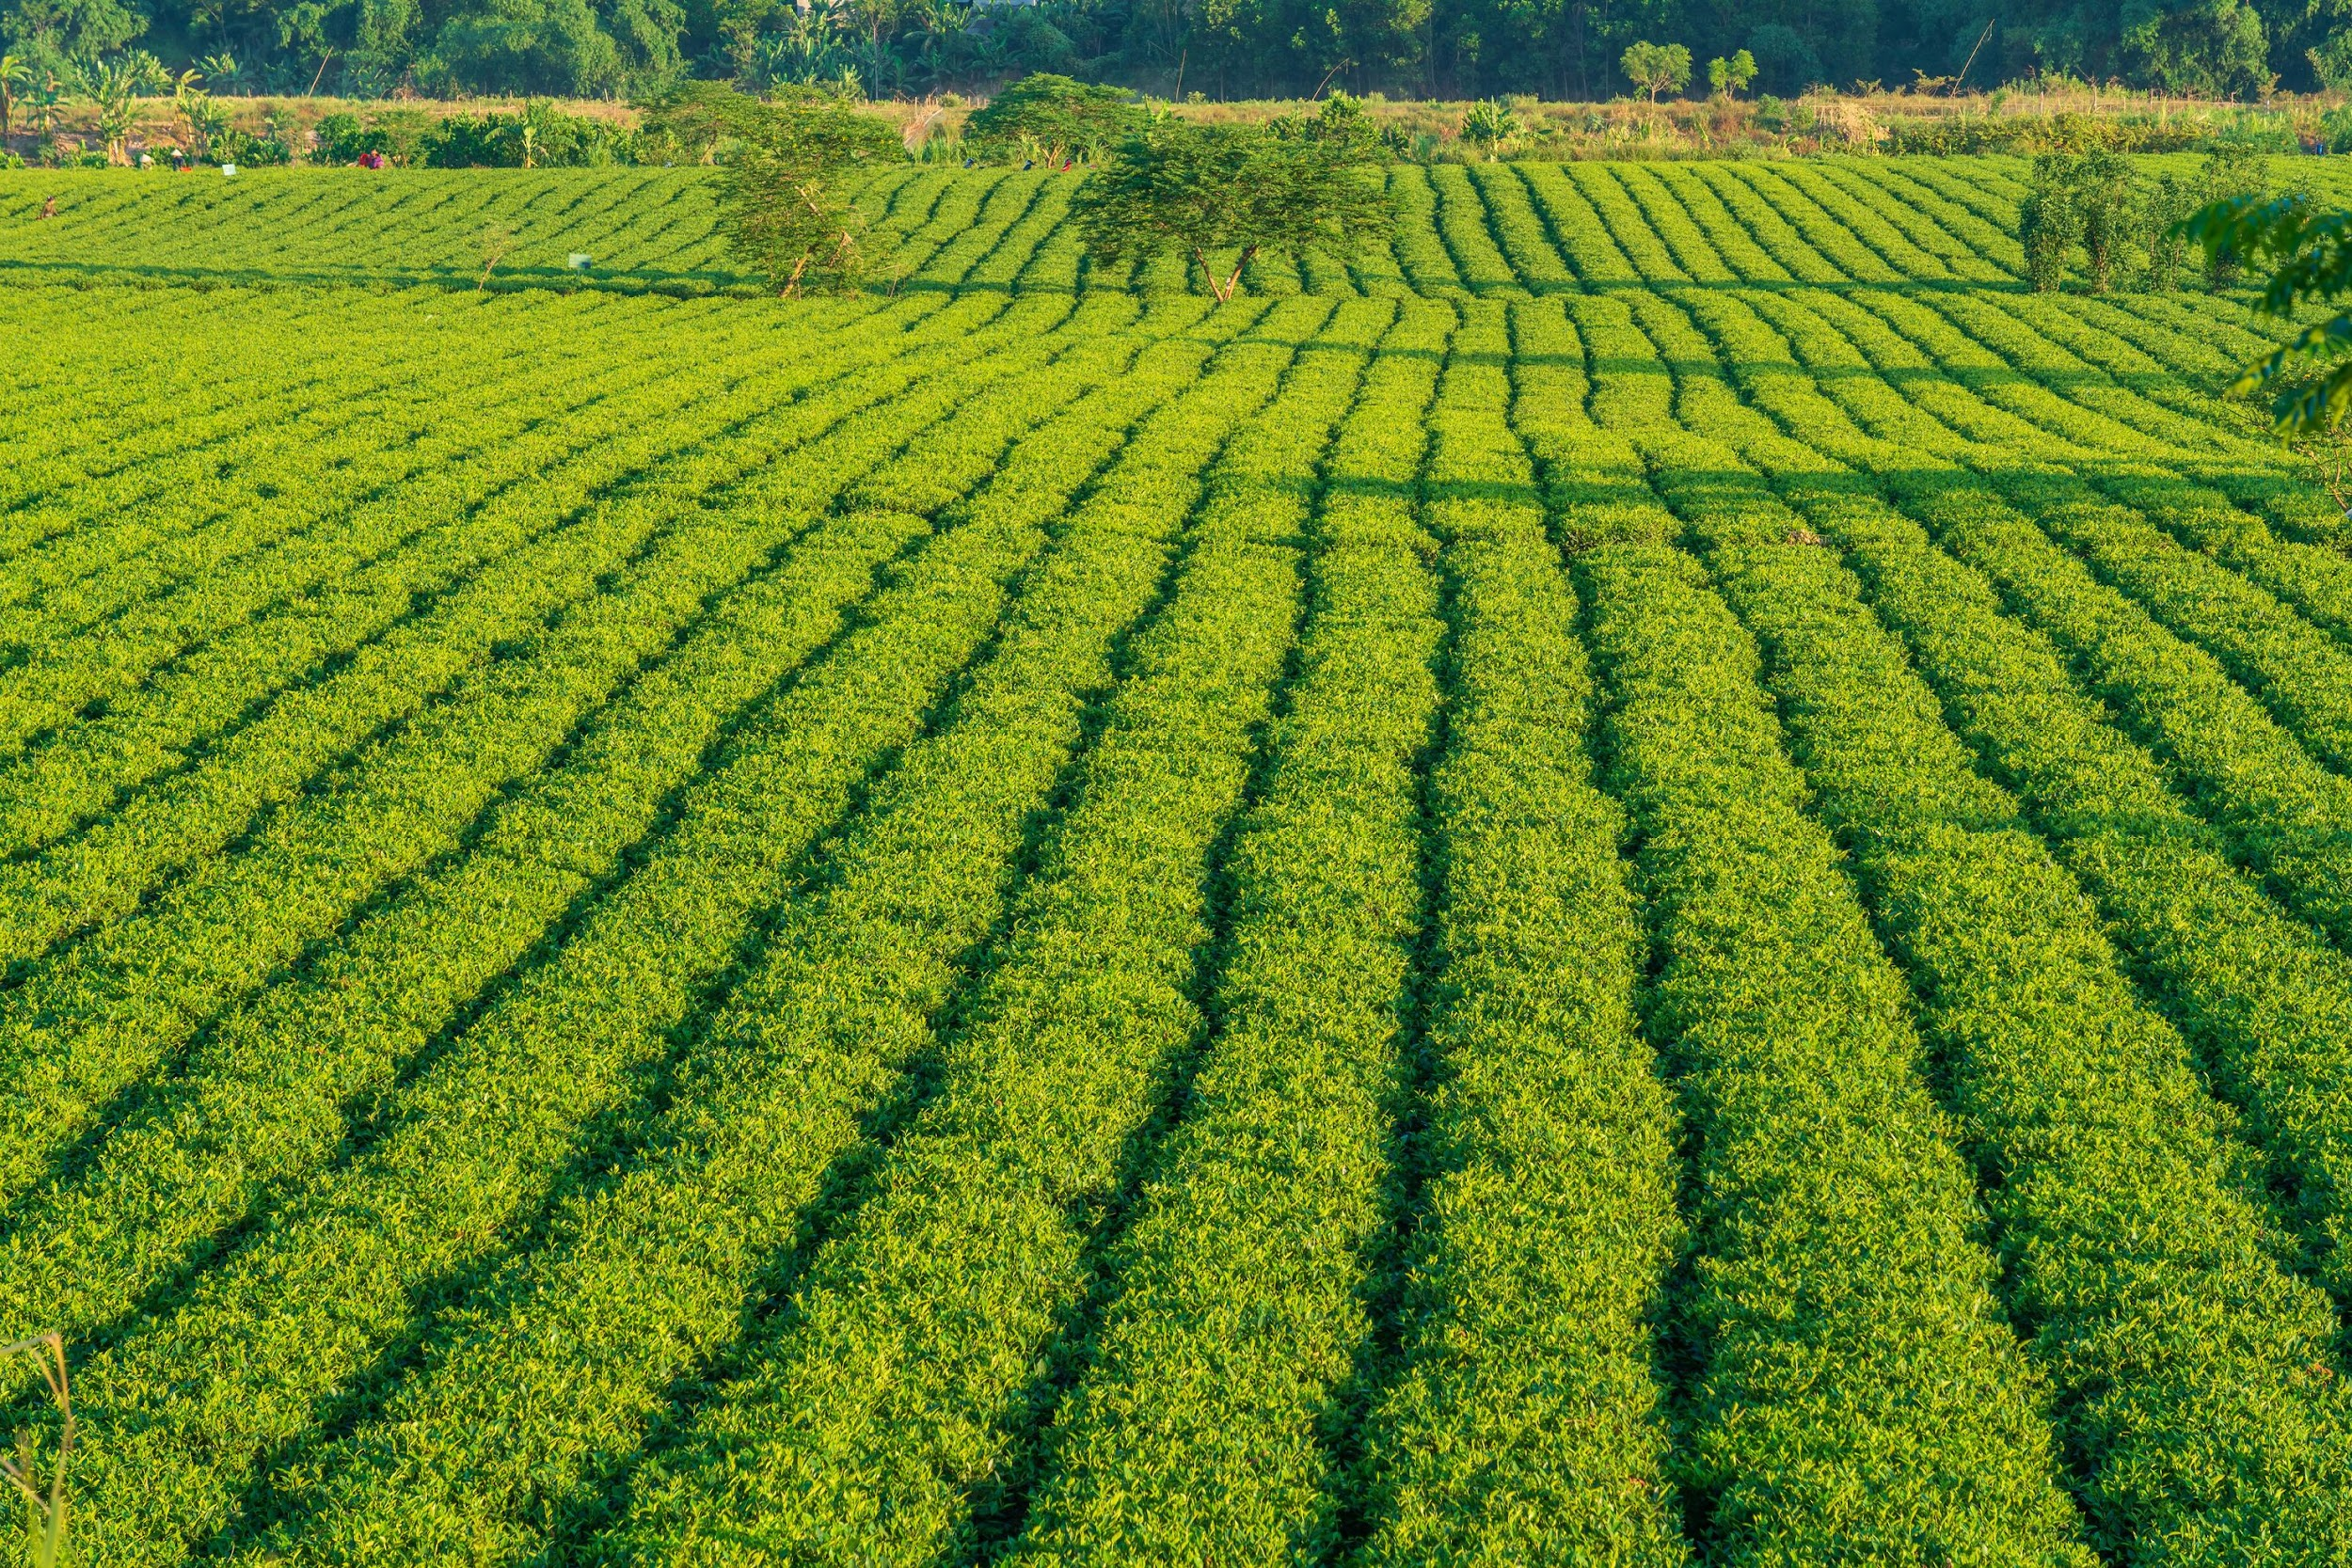

THANK YOU
PESTSENSE
FOR A SUSTAINABLE AGRIFUTURE

